Slide 1
Determining which variables contribute to shot success rate in soccer
Michael Womble, Daniel Diaz, Rose Mesina, and Ganesh Ghimire
March 8, 2022

Slide 2







G Data Set Overview:
2016:
1,974 Matches
3,251,294 events & 18 variables
2017 / 2018:
2018:

Slide 3
Variables:
Event Name
Subevent Name
Event Time
Event Coordinates
Player
Shots
Pass
Free Kick
Simple Pass
Cross
Goal Kick
x, y
start
end
Team
Match Date
Tags
Goals
Assist
Key Passes

Slide 4
Variables:
Event Name
Subevent Name
Event Time
Event Coordinates
Player
Shots
Pass
Free Kick
Simple Pass
Cross
Goal Kick
x, y
start
end
Team
Match Date
Tags
Goals
Assist
Key Passes

Slide 5
M SMART Question:
Based on the matches played during the 2017/2018 season for Europe’s top five leagues, the 2016 European Championship, and the 2018 World Cup, which match variables (ex: shot location, assist location, assist distance, etc…) result in the highest probability of a shot on goal being successful, result in a goal?

Slide 6

Approach:
Shots
Location
Assists
Distance
Key Passes

Slide 7
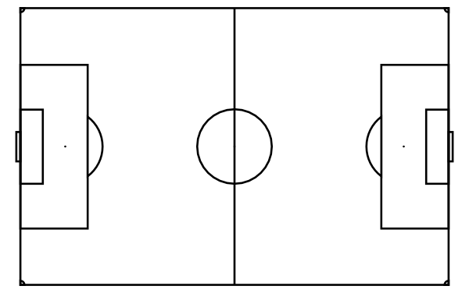
Understanding Field Coordinates:
100
y-coordinate
(x,y)
length
Attack
(x,y)
0
0
x-coordinate
100

Slide 8
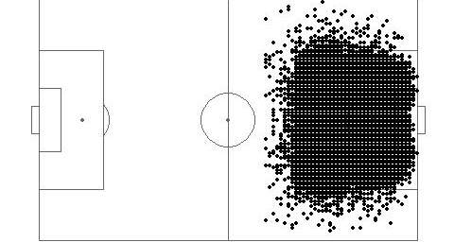
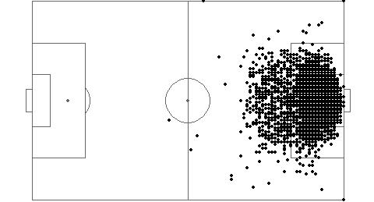
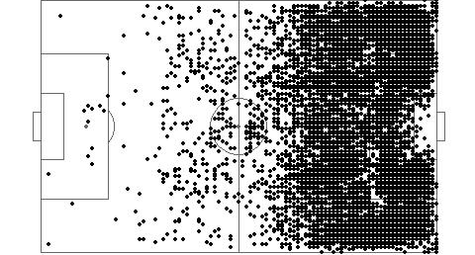
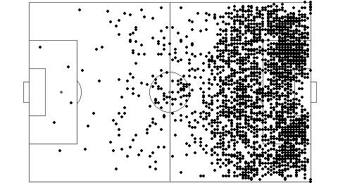
Starting Coordinates in the Data
Shots
Goals
Key Passes
Assists

Slide 9
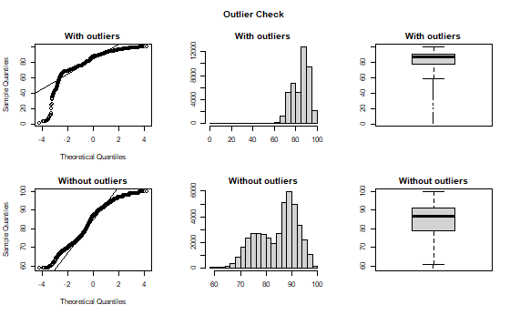
D Checking for Outliers:
Example: Shots

Slide 10
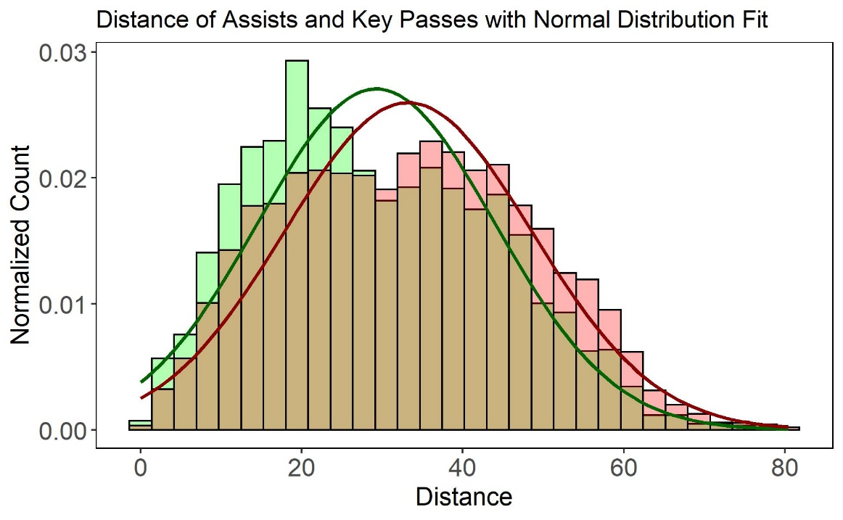
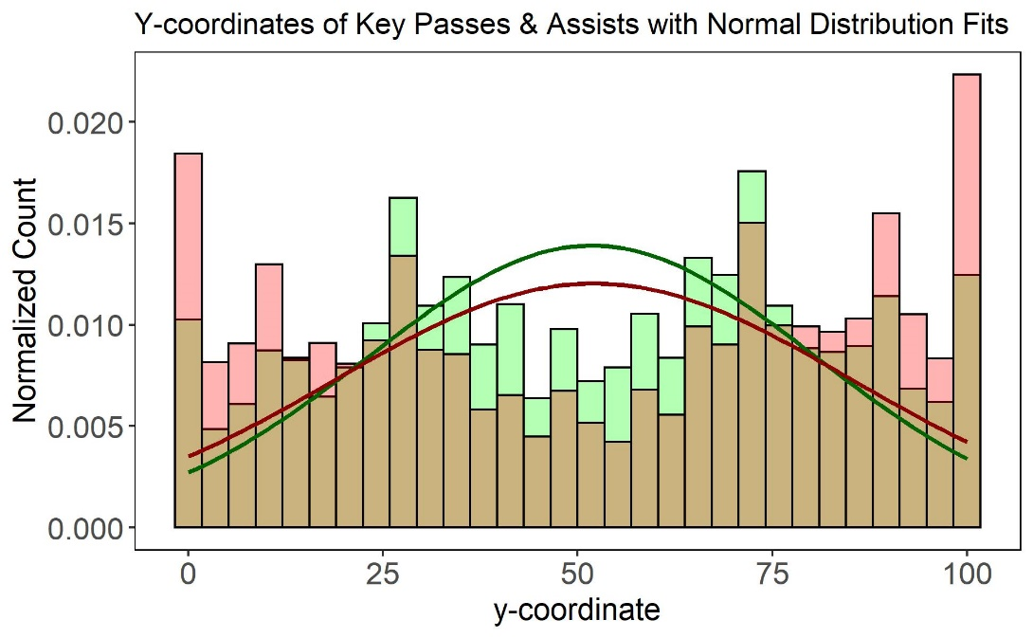
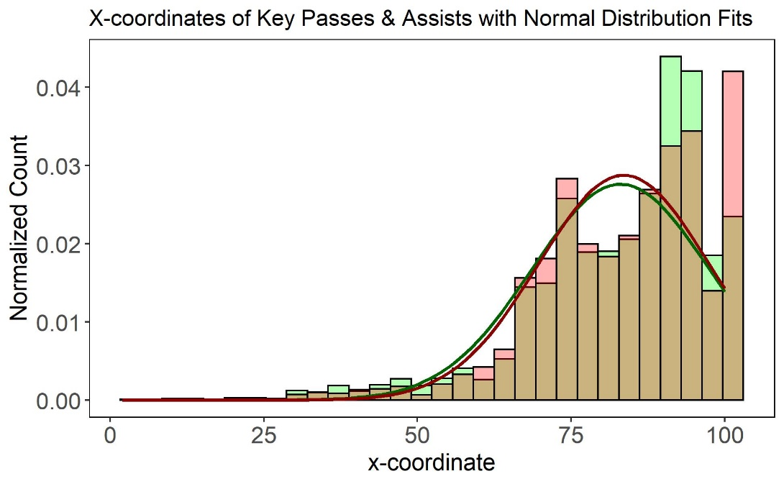
Hypothesis Testing: Assist vs Key Pass
Welch Two Sample t-test
p-value: <2e-16
Assist Mean: 29.2
Key Pass Mean: 33.2
Welch Two Sample t-test
p-value: 0.6
Assist Mean: 51.7
Key Pass Mean: 52.1
Welch Two Sample t-test
p-value: 0.9
Assist Mean: 84.7
Key Pass Mean: 84.7

Slide 11
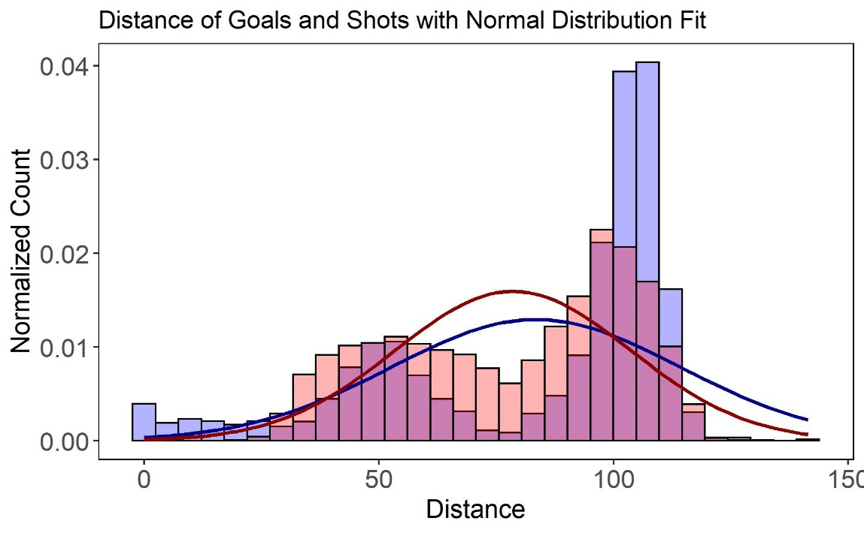
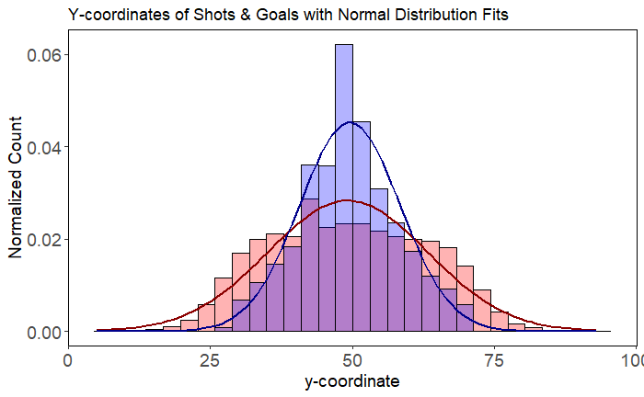
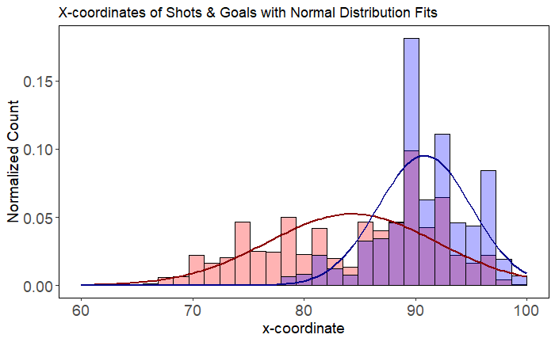
Hypothesis Testing: Shot vs Goal
Welch Two Sample t-test
p-value: <2e-16
Goal Mean: 83.4
Shot Mean: 78.6
Welch Two Sample t-test
p-value: <2e-16
Goal Mean: 68.1
Shot Mean: 49.2
Welch Two Sample t-test
p-value: <2e-16
Goal Mean: 93.5
Shot Mean: 84.3

Slide 12
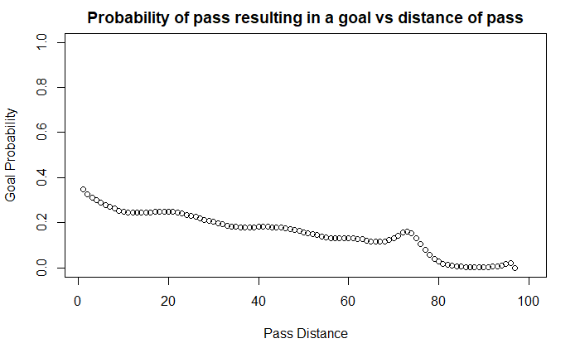
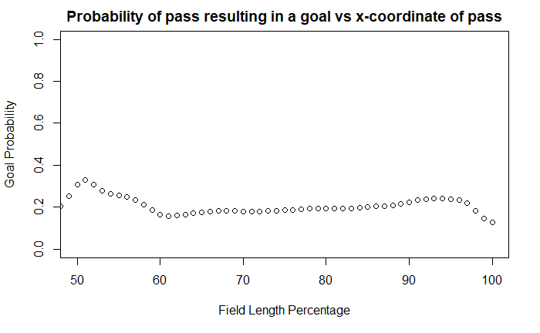
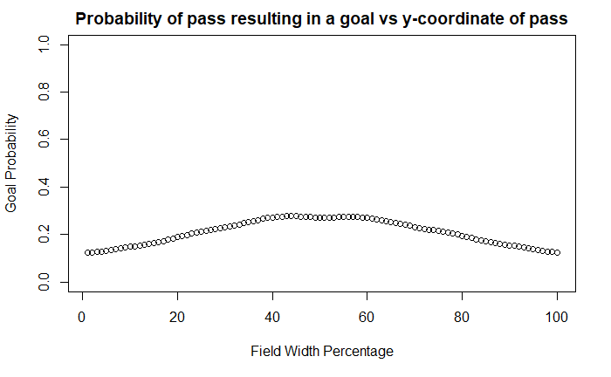
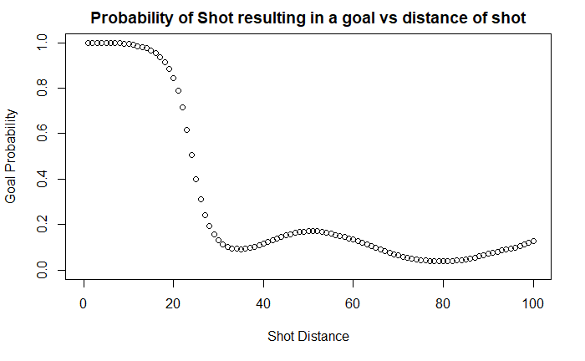
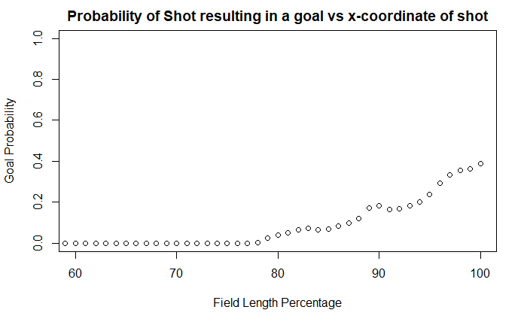
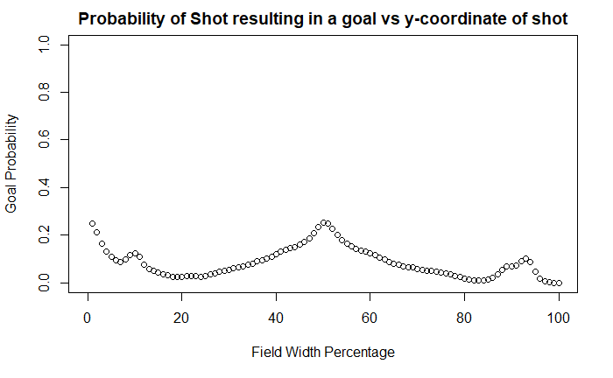
M Success Probability Plots

Slide 13
R Hypothesis Testing Recap
Significant Difference in Means
Assist v. Key Pass Distance (higher mean for key pass)
Goal v. Shot Distance (higher mean for goals)
Goal v. Shot x.Start (higher mean for goals)
Goal v. Shot y.Start (higher mean for goals)
Do teams differ in their strategies when it comes to the above variables? Let’s take a look at some Teams in the World Cup.

Slide 14
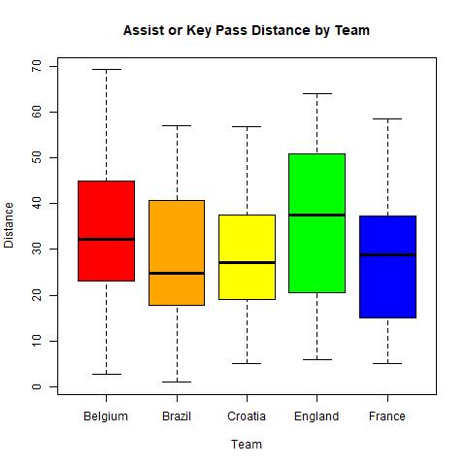
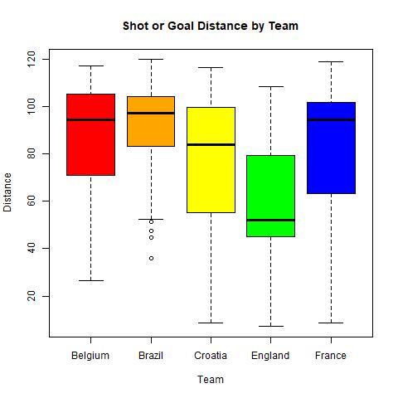
Hypothesis Testing: Means Between Teams Using ANOVA
ANOVA
p-value: 0.07
ANOVA
p-value: 7.74e-18

Slide 15
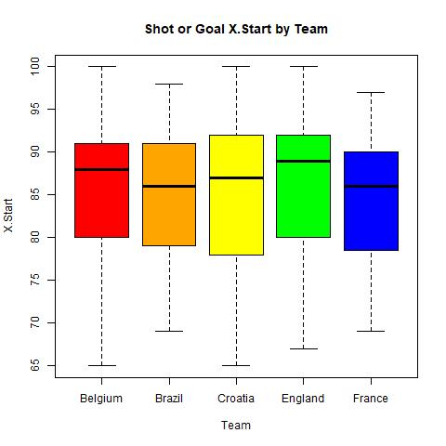
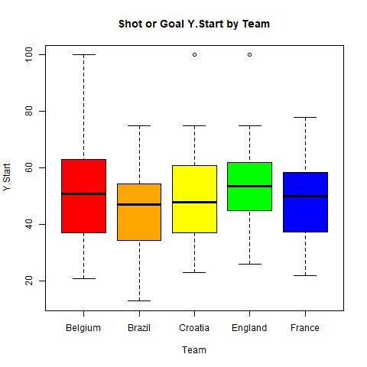
Hypothesis Testing: Means Between Teams Using ANOVA
ANOVA
p-value: 0.153
ANOVA
p-value: 0.002

Slide 16
Conclusions:
Based on t-tests done between Shots vs Goals, and Assists vs Key Passes, there is evidence of distance and start coordinate differences between successful and unsuccessful plays.
Success probability plots show that all variables selected play a significant role in the success of shot or assist/key pass resulting in a goal.
Most influential appears to be shot distance
Least influential appears to by the x-coordinate of final pass (assist/key pass)
Applying this finding to the top 5 teams in the World Cup, we see further that there are teams that are significantly different in their tendencies for distance and Y.Start when it comes to attempting a goal.

Slide 17
Next steps
Adjust fitting to better account for non-normal distributions
Further exploration of data by groups (by league, etc?)
Improving visualizations (3D plots)
Linear model

Slide 18




Q&A?
Thank You!

